Slide 1
BUBBLE-TALK
A universal language for gas in liquids

Slide 2
Introduction
What is Bubble-Talk?
  Method & apparatus for industrial mixing designed to meet 4 criteria:
    Transforming large gas bubbles into increasingly smaller ones
    Homogenizing rapidly
    Preventing the clogging of solids
    Attaining a long term stability of reacted products
    Where does Bubble-Talk come from?
    Some time ago, a knowledgeable industry insider has proposed the Bubble-Talk concept to us as a design challenge
    This person maintains that mixing today is predominantly a “wild-west affair” costing money and time and which by and large is essentially inefficient

Slide 3
Purpose
    Why this workshop and discussion?
  To determine whether or not Bubble-Talk may be considered as a possible solution to the many mixing problems encountered by the industry

Slide 4
Bubble-Talk team
Who are we?
  A team of individuals having complementary skills
    Mechanical/Structural Engineering (Francois Bernard CEO)
    Financial architecture (Dennis Wareman CFO)
    Control Engineering (Anton Stevense)
    Chemical Engineering & IP Management (Tjitte Nauta PM)
    Oscar Menzel ( Design & modelling )
What do we offer?
  Innovative Solutions – e.g.
    Hydro-acoustic positioning
    Deep Water Robotics etc….
    Bubble-Talk mixer

Slide 5
Business opportunities
Target Markets
  Initially:
    Horticulture /Agriculture
  Subsequently:
    Hydrogenation of edible oil (Palm – Soya)
    Oxidation of Toluene (Towards benzoic acid)
    Oxidation of P-Xylene ( Towards terephthalic acid)
    Oil & Gas (Kuwait Institute for Scientific Research)
    Mining (United Commodities Ontario, Canada)
    Fermentation

Slide 6
Market requirements
Target market needs
  Sustainable Solutions
    Efficient use of raw materials
      minimum amount of gas etc…
    Byproduct limitation
      less cyanide in gold leaching etc…
    Energy Efficiency
      minimum power input
    Rapid Homogenization
      Emulsification etc…

Slide 7
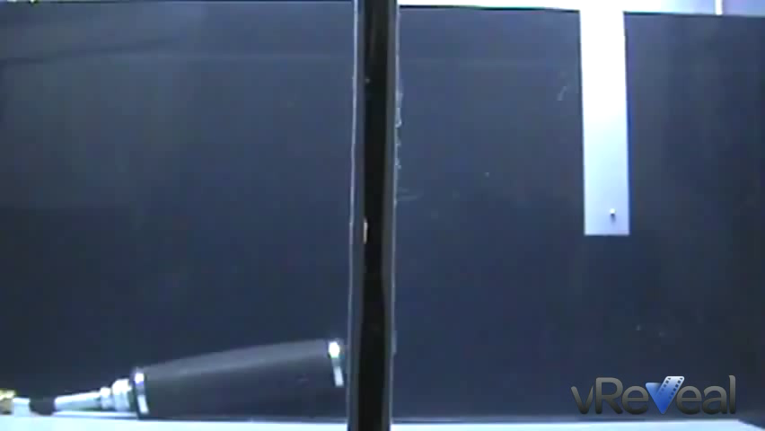
Competitive solutions
Spargers …

Slide 8
Impellers
Centrifugal forces = poor dispersion, poor homogenization & total absence of gas particle stability

Slide 9
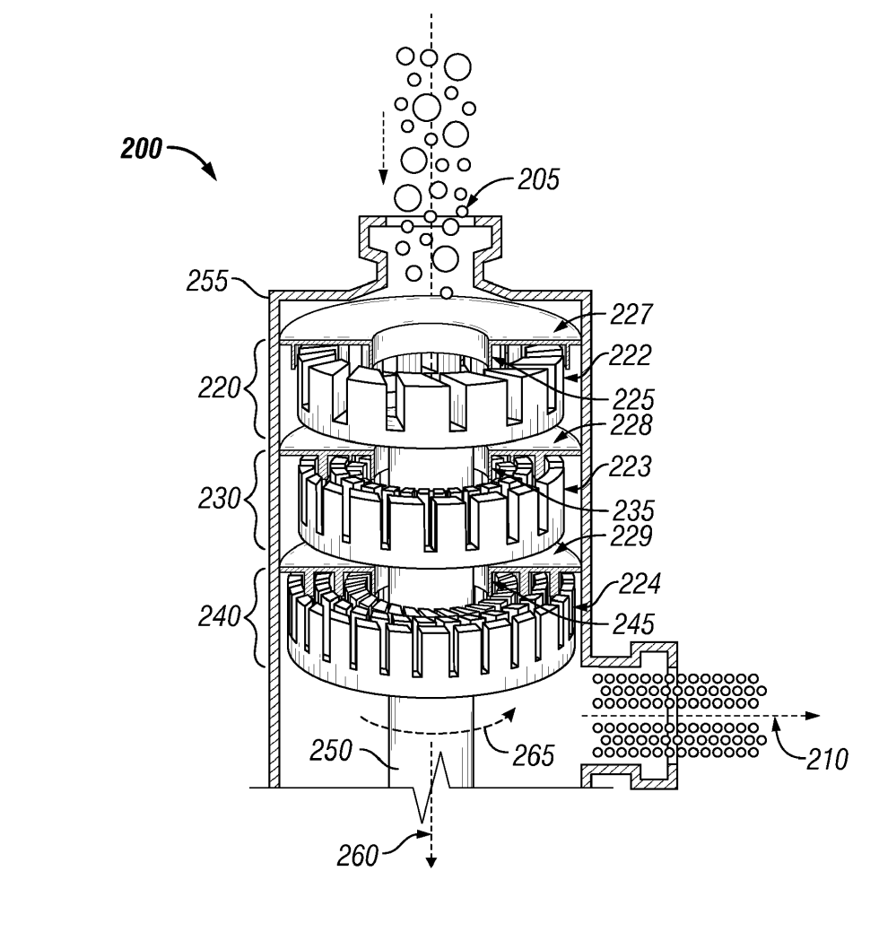
Rotor/stator

Slide 10
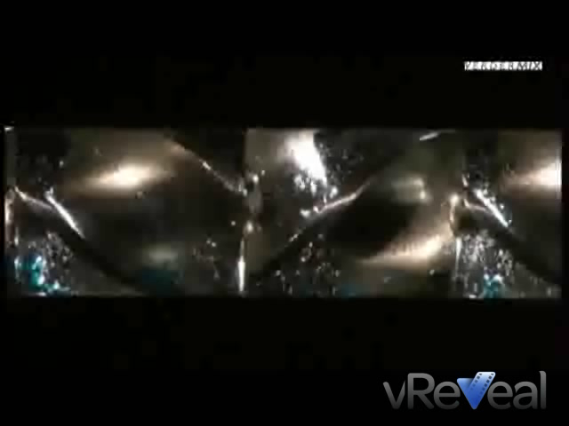
In-line mixers

Slide 11

Bubble columns

Slide 12
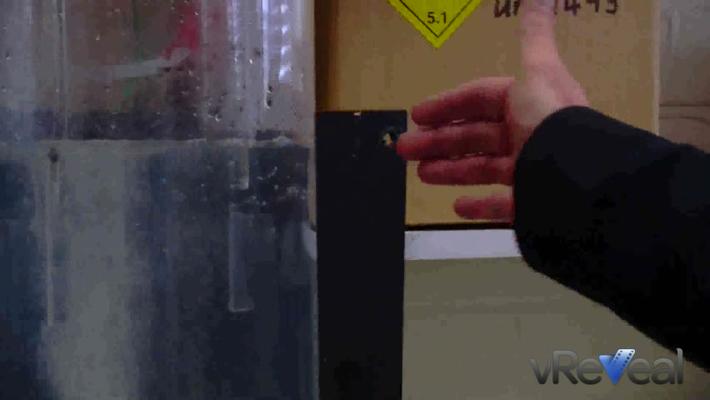
Bubble columns

Slide 13
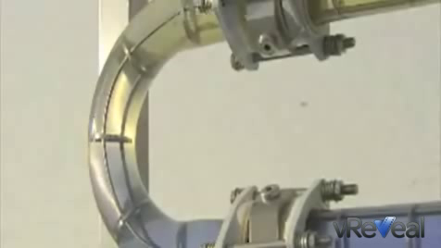
Oscillating systems

Slide 14
Competitive solutions
Common denominator:
  Coalescence issues when homogenization and recirculation are simultaneously required
  Limitation of gas particles size (always above the range of light wavelength)
  Stability limitations

Slide 15
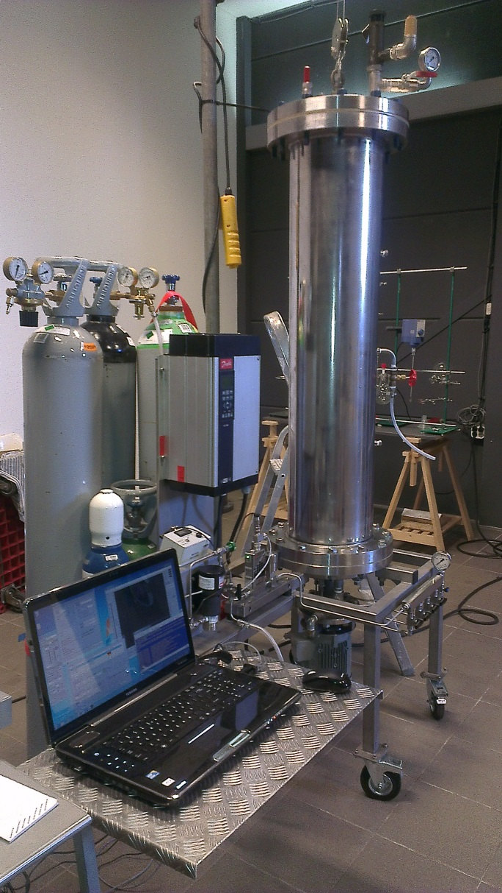
Bubble-Talk solutions
a Patent is pending for Bubble-Talk hence …
Explanation of System engineering is kept to a strict minimum, e.g. …
Rotor/stator + mesh = Black box

Slide 16
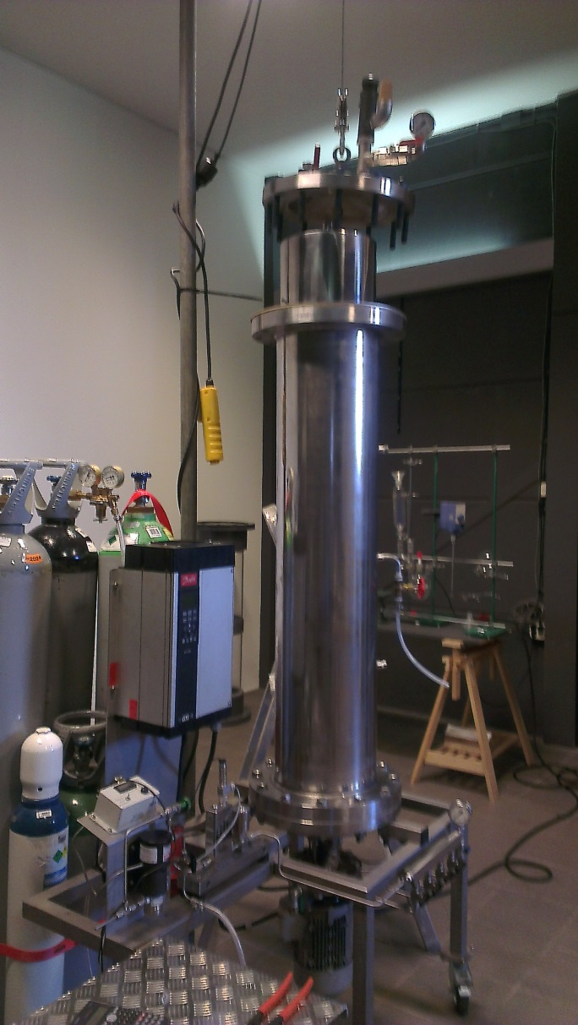
Bubble-Talk hardware
Reactor volume: 75 L
Temperature: ambient
Pressure: 20 bar max.
Motorization: 380V/50Hz/1.5 kW
Revs setting: 1480 rpm@50Hz
Process/manipulation: Explanation

Slide 17
Bubble-Talk protocol
Reactor charged with water (75 L)
Open gas line to show initial bubble size (10L/min)
Impeller on at … (30Hz)
Pressurize up to ... (3 bars)
Close gas line
Recirculation
Gas management & overhead space
Reduce impeller to maintenance rate (20 Hz)
System stop to complete stabilization (brief fizzing at first)

Slide 18
Bubble-Talk gas holdup verification
Restart impeller (30 Hz)
Add foaming agent
Homogenize (5 minutes)
Take sample
System stop
Allow to separate (*)
* Time required is inversely proportional to slurry homogenization quality

Slide 19
Bubble-Talk observations
Initially: coarse bubbles & “controlled” chaos
due to created conditions
Gradually: bubble size reduction & alignment
Then: small fraction of bubbles visible as fizz
Ultimately: essentially clear solution (no visible bubbles)
After adding surfactant: milky dispersion
After separation: thick foam layer (volume verification of gas holdup)

Slide 20
Bubble-Talk services
MassMix bubbles:
Customization
Scalable units
Performance validations
R & D
License/Sales

Slide 21
Bubble-Talk advantages
So are we sustainable?
Let’s see …
Efficient use of gas
Low power input
Rapid homogenization
Minimization of byproducts

Slide 22
Further steps
Select strategic partners
Optimization & Instrumentation
Qualitative & quantitative verification (specific pilots)
Protection & IP
Modelling & scale-up
Full roll out

